Slide 1
Azan Timing Management System
By
Syed Taha anwer 10384

Slide 2
introduction
This is a Azan Timing Management System(ATMS) in which we have a source where we are getting a time, and we have a 6 countries and every country connected there own a cities. And the main source send a accurate time to the specific country.

Slide 3
objective
The main objective of this management system is that controlling or managing a Azan time. It’s directly connected with the sun so it can easy to find a correct time of Azan.

Slide 4
protocol
FTP
DHCP

Slide 5
hardware
Server
Switches
Routers
Pc’s

Slide 6
Shadow
Cities
Cities
Cities
Country 1
Country 2
Country 3
Sun
Receiver
Country 4
Country 5
Country 6
Cities
Cities
Cities

Slide 7
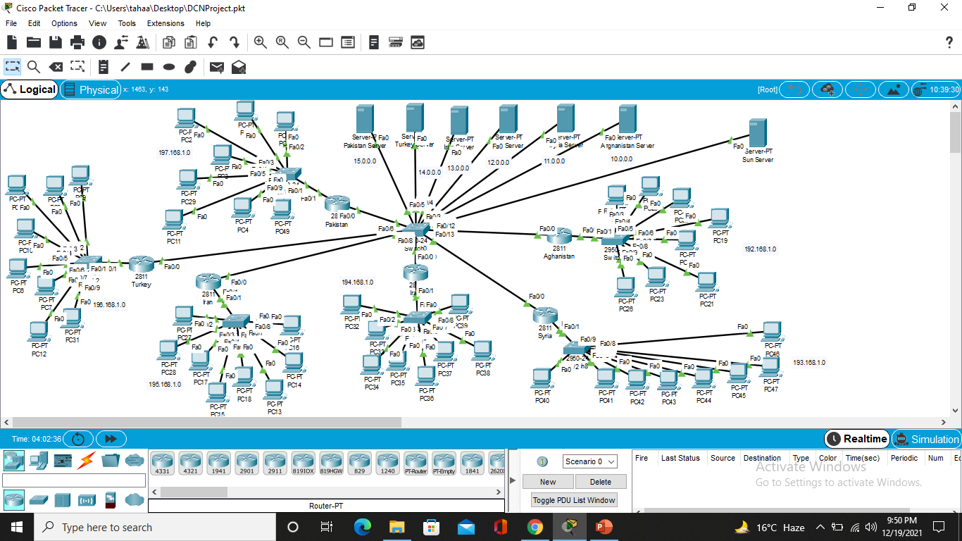
topology
Countries
Sun
Receiver
Cities

Slide 8
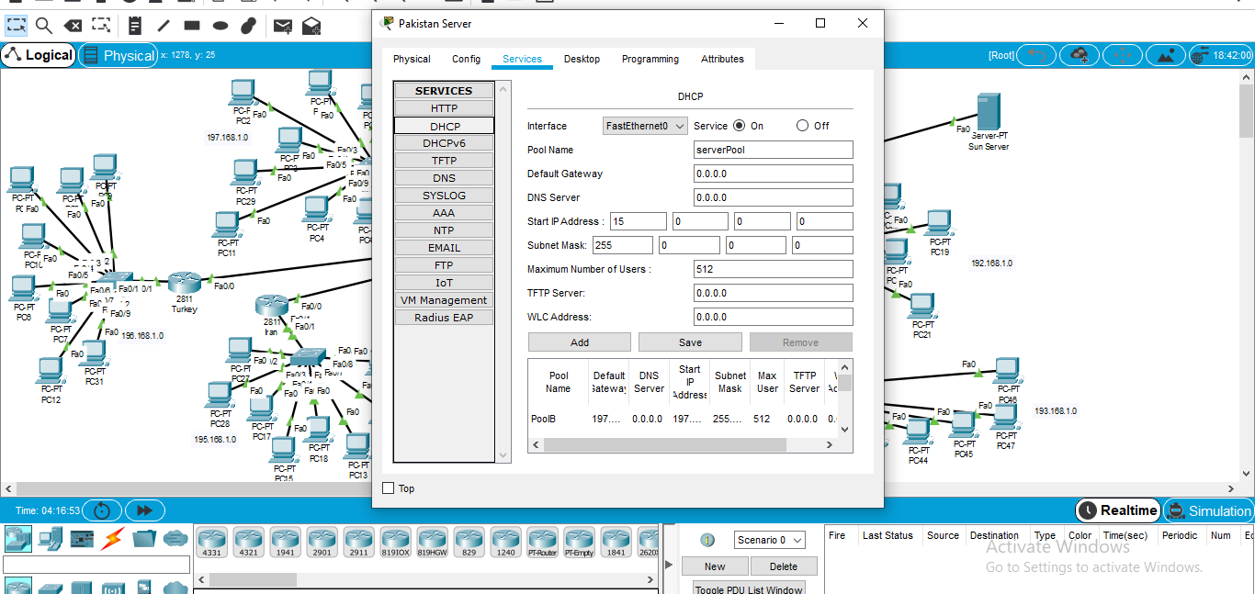
DHCp

Slide 9
DHcp server configuration
Assign IP on DHCP Server
Configure DHCP Server
Assign Helper Address
Dynamic IP’s of Pc
Step 1
Step 2
Step 3
Step 4

Slide 10
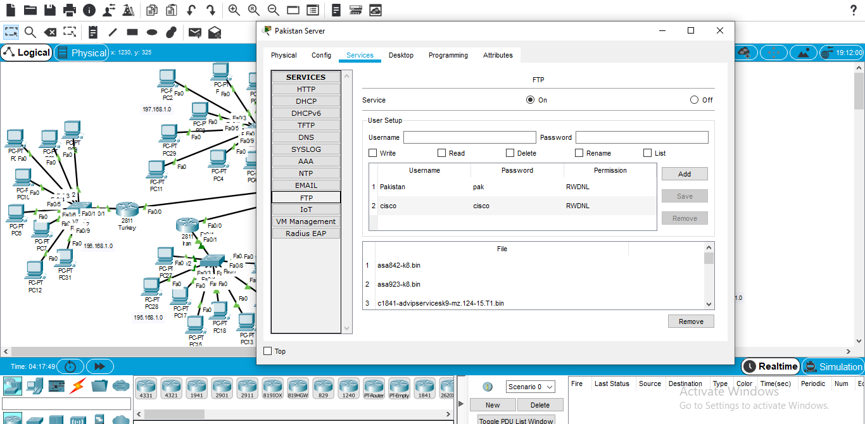
ftp

Slide 11
Use of FTP
Activate FTP Service
Create Text File
Upload File
Step 1
Step 2
Step 3

Slide 12
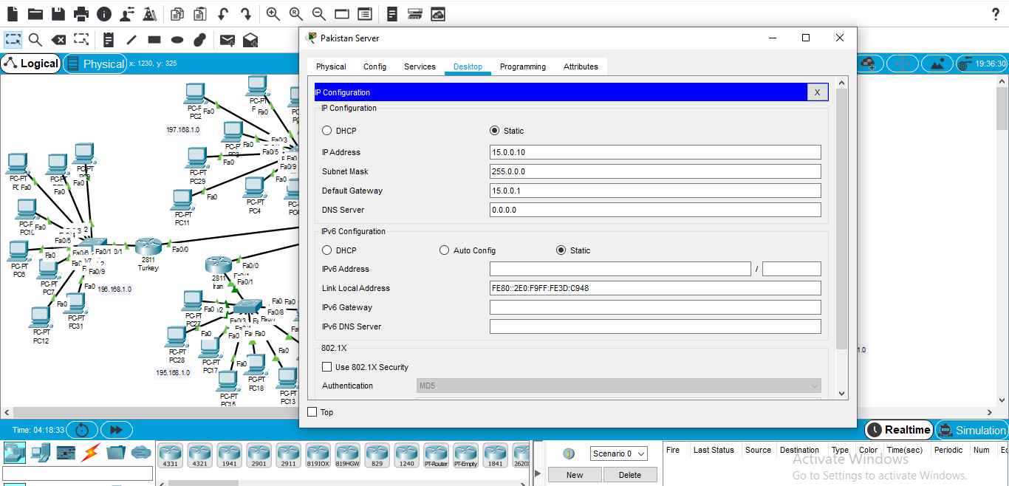
Server ip

Slide 13
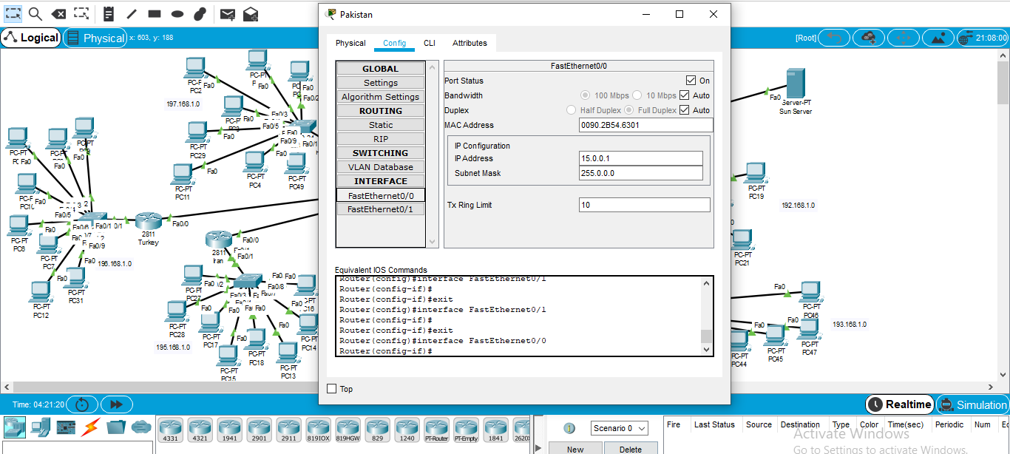
Router ip

Slide 14
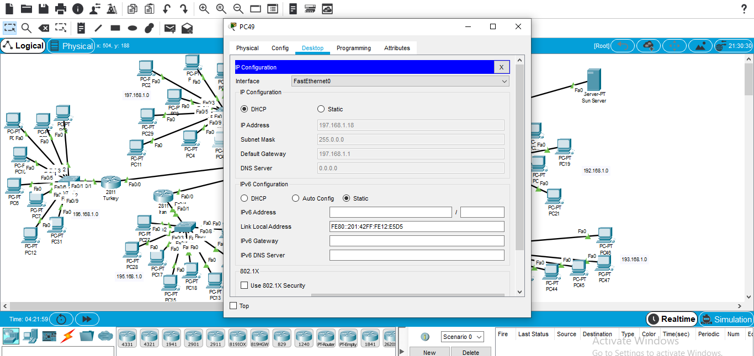
Pc DHCp

Slide 15
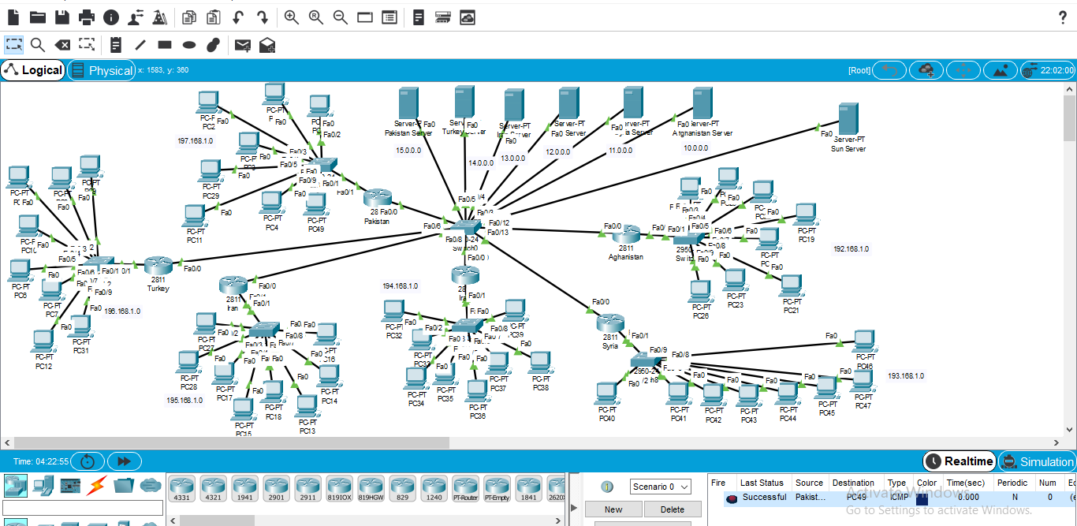
Packet send

Slide 16
Thank you!!

